Slide 1
Machine learning : classification
By Vinh Vu
LinkedIn: https://www.linkedin.com/in/vinh-v-0b9059163/

Slide 2
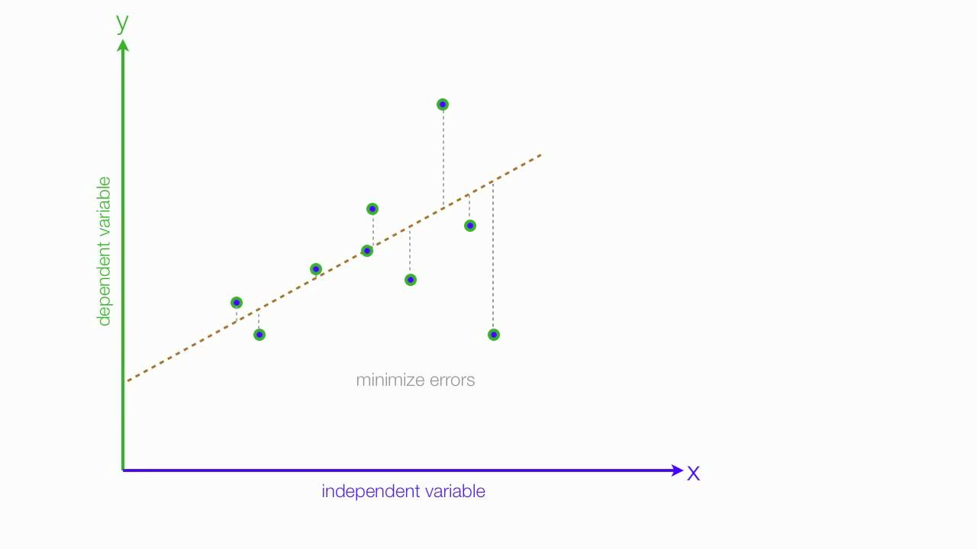
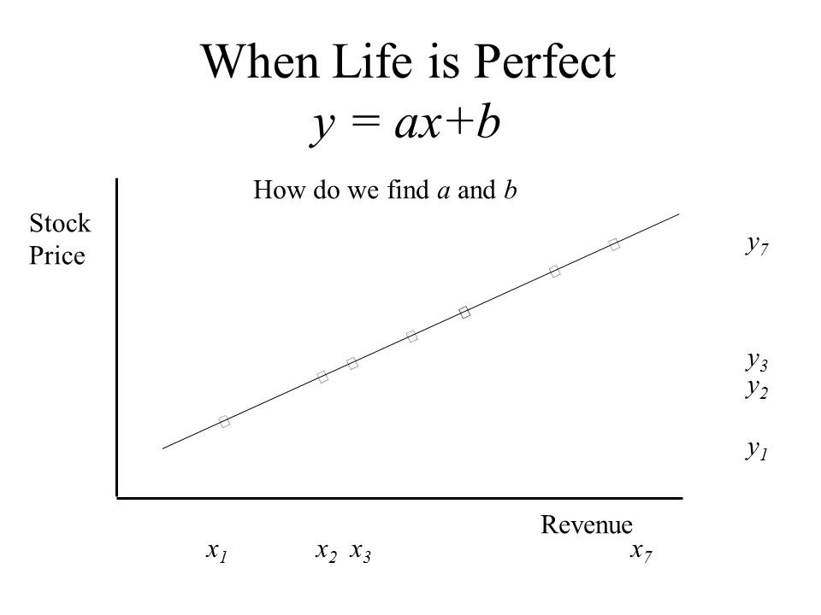
Machine learning
A regression problem is when the output variable is a real or continuous value, such as “salary” or “weight”. Many different models can be used, the simplest is the linear regression. It tries to fit data with the best hyper-plane which goes through the points.

Slide 3
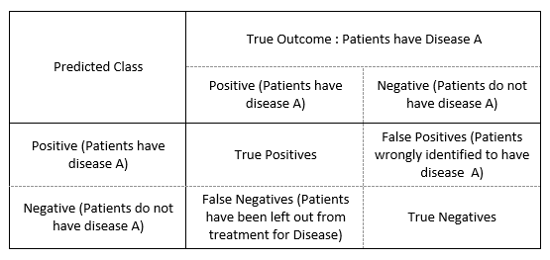
A classification problem is when the output variable is a category, such as “red” or “blue” or “disease” and “no disease”. A classification model attempts to draw some conclusion from observed values. Given one or more inputs a classification model will try to predict the value of one or more outcomes.

Slide 4
About the project:
My client, Telco Company, is a telephone and internet service provider with over 5000 customers. In order to grow and maintain profitability, it’s essential that they learn how to maintain a dedicated customer base and reduce churn. Based on my analysis, Telco can:
Identify customers that are likely to churn and reach out to them to try to stop them from churning via special offers targeted to their needs
Focus marketing on customers that are more likely to be long term customers
Modify their services to improve the likelihood customers will stay longer term

Slide 5
Data set
Attribute | Description
CustomerID | Customer ID
Gender | Customer gender (female, male)
SeniorCitizen | Whether the customer is a senior citizen or not (1, 0)
Partner | Whether the customer has a partner or not (Yes, No)
Dependents | Whether the customer has dependents or not (Yes, No)
Tenure | Number of months the customer has stayed with the company
PhoneService | Whether the customer has a phone service or not (Yes, No)
MultipleLines | Whether the customer has multiple lines or not (Yes, No, No phone service)
InternetService | Customer’s internet service provider (DSL, Fiber optic, No)
OnlineSecurity | Whether the customer has online security or not (Yes, No, No internet service)
OnlineBackup | Whether the customer has online backup or not (Yes, No, No internet service)
DeviceProtection | Whether the customer has device protection or not (Yes, No, No internet service)
TechSupport | Whether the customer has tech support or not (Yes, No, No internet service)
StreamingTV | Whether the customer has streaming TV or not (Yes, No, No internet service)
StreamingMovies | Whether the customer has streaming movies or not (Yes, No, No internet service)
Contract | The contract term of the customer (Month-to-month, One year, Two year)
PaperlessBilling | Whether the customer has paperless billing or not (Yes, No)
PaymentMethod | The customer’s payment method (Electronic check, Mailed check, Bank transfer (automatic), Credit card (automatic))
MonthlyCharges | The amount charged to the customer monthly
TotalCharges | The total amount charged to the customer
Churn | Whether the customer churned or not (Yes or No)

Slide 6
Constructing the Data:
Convert columns with yes/ no to 1/0
When a column has multiple values, I use get_dummy function turning a column to multiple columns
Customer ID | automatic desposit | cash | check
4562 | 1 | 0 | 0
4563 | 0 | 1 | 0
4564 | 0 | 0 | 1
4566 | 1 | 0 | 0
4567 | 0 | 1 | 0
4568 | 0 | 0 | 1
Customer ID | Payment Type
4562 | automatic desposit
4563 | cash
4564 | check
4566 | automatic desposit
4567 | cash
4568 | check

Slide 7
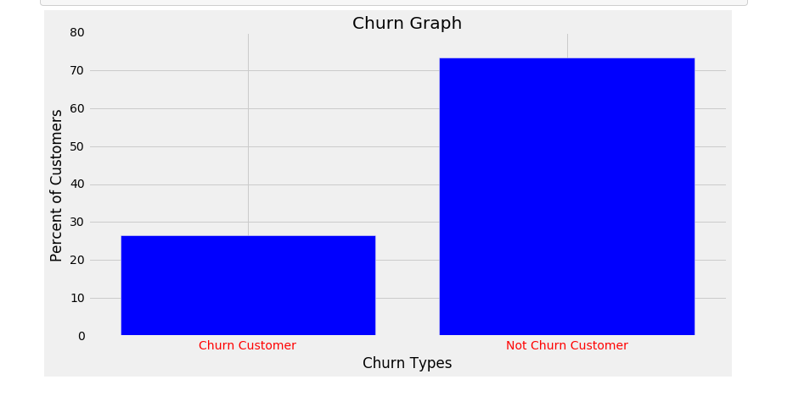
Exploring the Data
71.5%
28.5%
Imbalanced classes

Slide 8
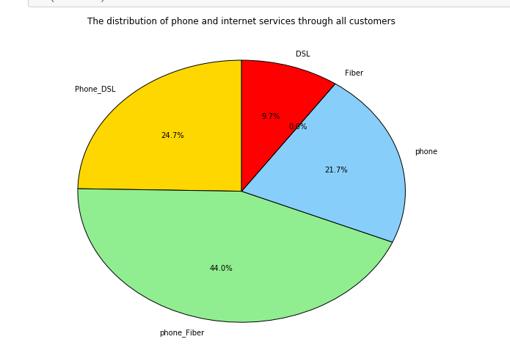
Services:

Slide 9
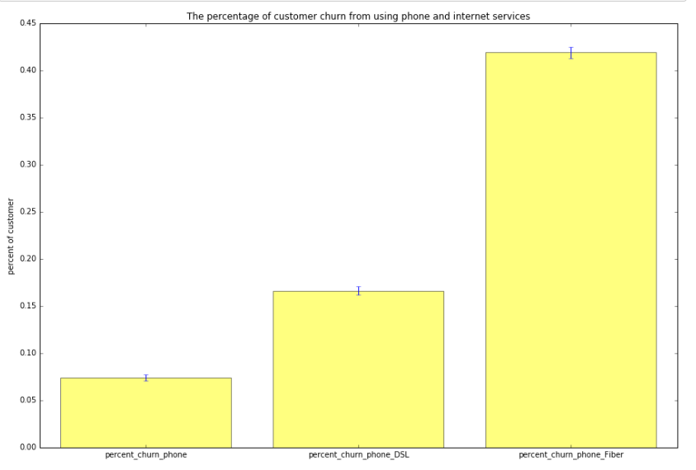
The percentage of customer churn from using phone and internet services:
41%
16%
7 %

Slide 10
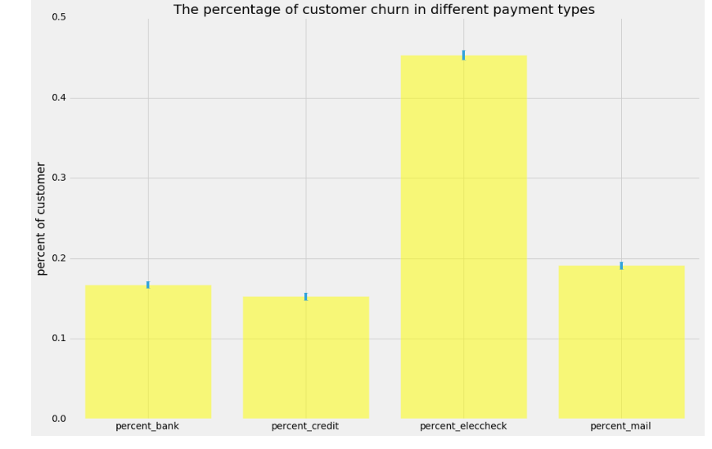
Payment types:
42%
19%
16%
15%

Slide 11
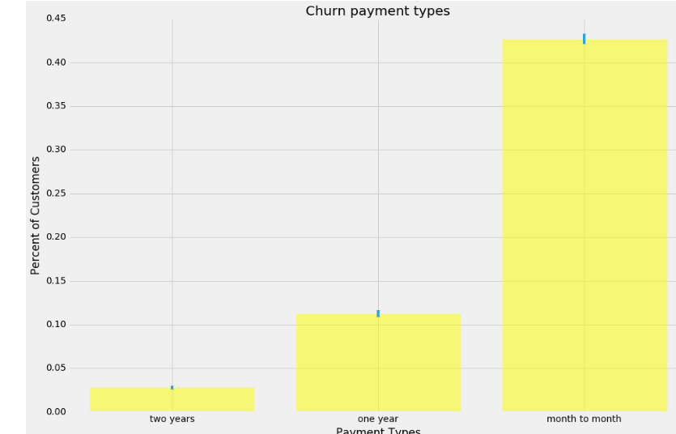
Payment types:
42%
11%
2%

Slide 12
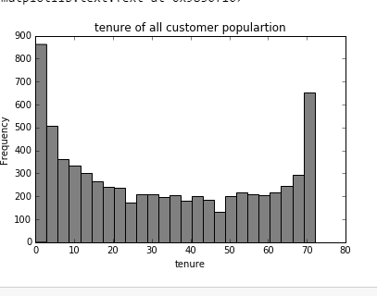
Tenure:

Slide 13
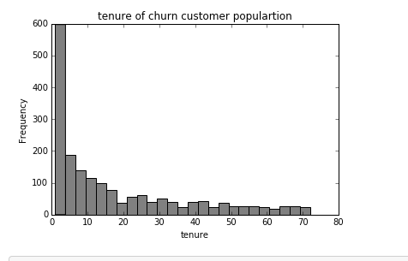
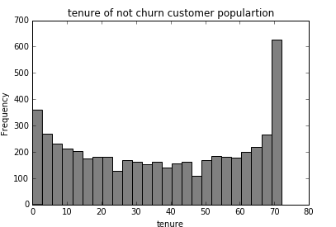
Tenure:

Slide 14
Machine Learning:
Discover Data Trends
Predict the best way to increase profit
Evaluate data analysis
Marketing purpose

Slide 15
Machine learning:
The data set is an imbalanced problem.
We measure model performance through different errors and concepts; such as Precision, recall.
Precision is sort of like accuracy but it looks only at the data you predicted positive (in this example you’re only looking at data where you predict a churn) (PPV).
Recall is also sort of like accuracy but it looks only at the data that is “relevant” in some way. (TPR)

Slide 16
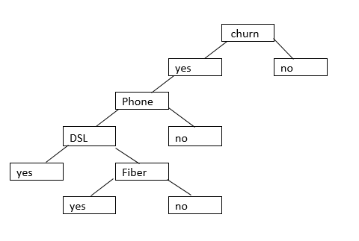
Decision tree:

Slide 17

Random forest:

Slide 18
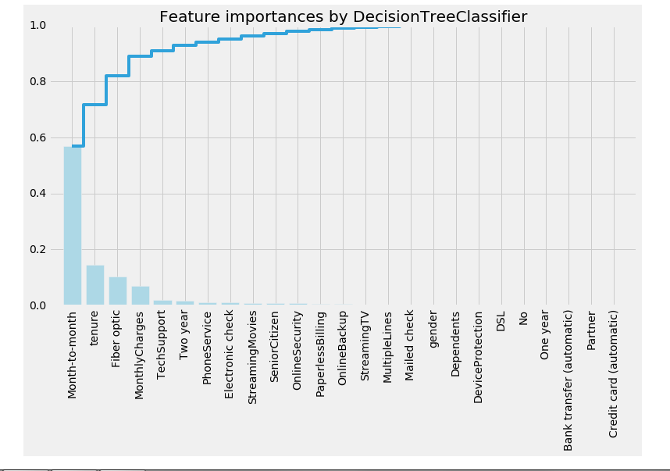
Feature important:

Slide 19
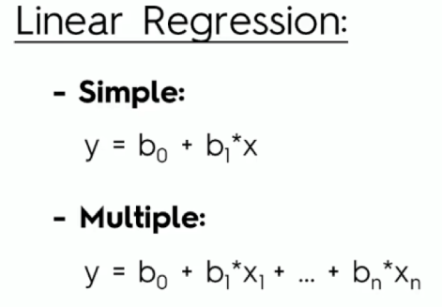
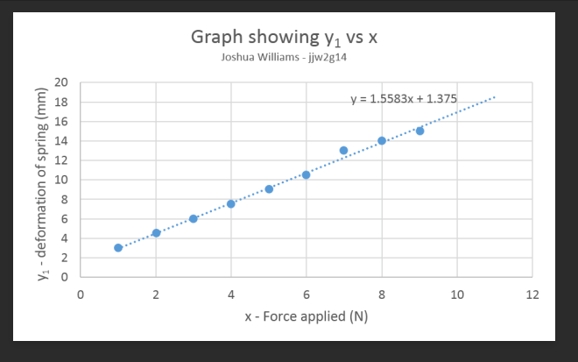
Logistic regression:

Slide 20
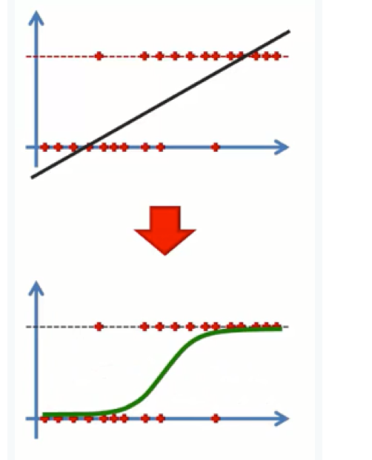
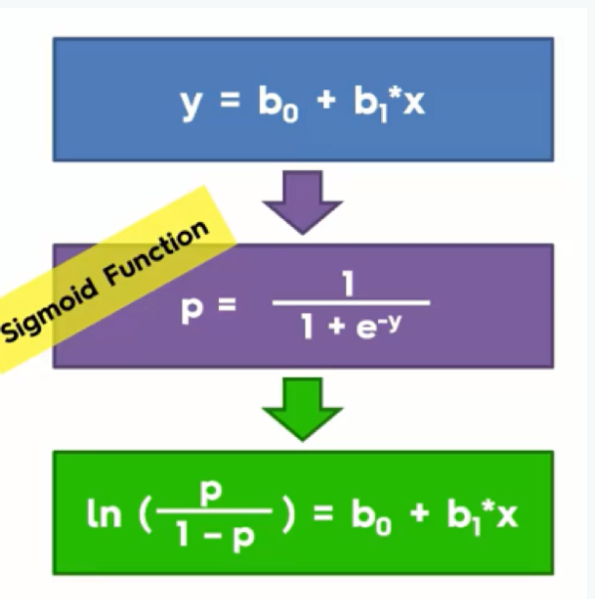
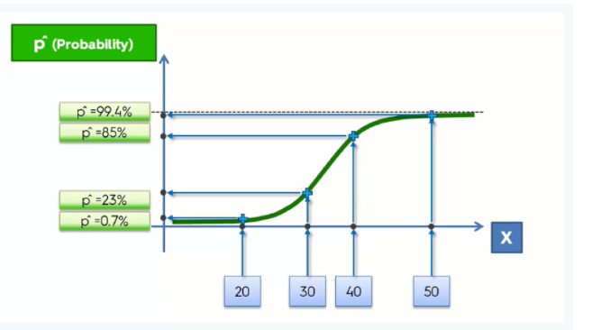
Logistic regression:

Slide 21
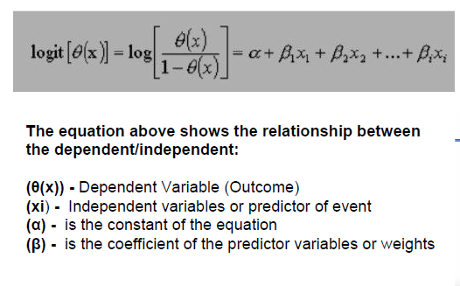
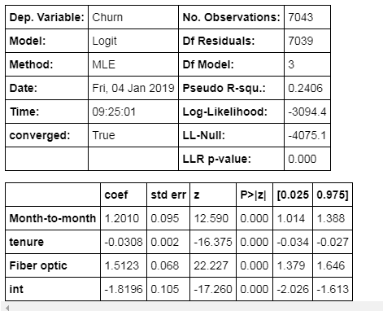
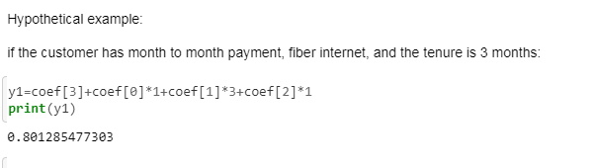
Probability of customer churn:

Slide 22
Probability of customer churn:
Customer ID | Fiber | Tenure | month to Month | probability
7590-VHVEG | 0 | 1 | 1 | -0.6494
5575-GNVDE | 0 | 34 | 0 | -2.8668
3668-QPYBK | 0 | 2 | 1 | -0.6802
7795-CFOCW | 0 | 45 | 0 | -3.2056
9237-HQITU | 1 | 2 | 1 | 0.8321

Slide 23
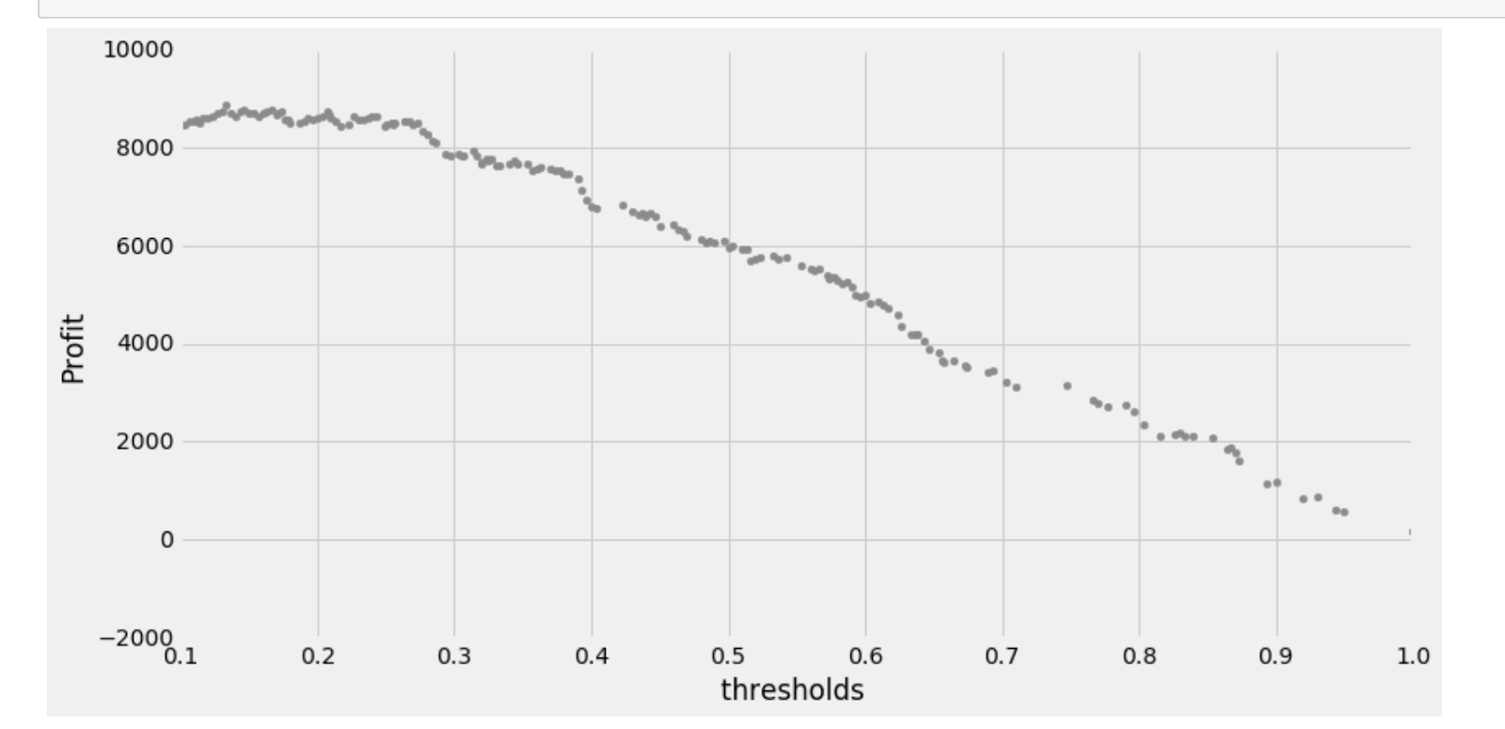
Profit curve
Labor is $20
The customer lifetime value is $100

Slide 24
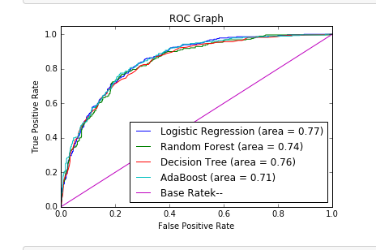
ROC curve:

Slide 25
Conclusion:
In summary, this is what we know about why customers churn:
Customer are most likely to churn if they are the month to month payment type.
Customer is likely to churn in first ten months.
Customers is likely to leave when they use Fiber optic service.
there is 0% customers use fiber only, customers are likely to cancel services when they use phone and fiber.
month to month, tenure, and fiber optic are the three most significant features in determining churn.

Slide 26
